Slide 1

E.H.F

Slide 2
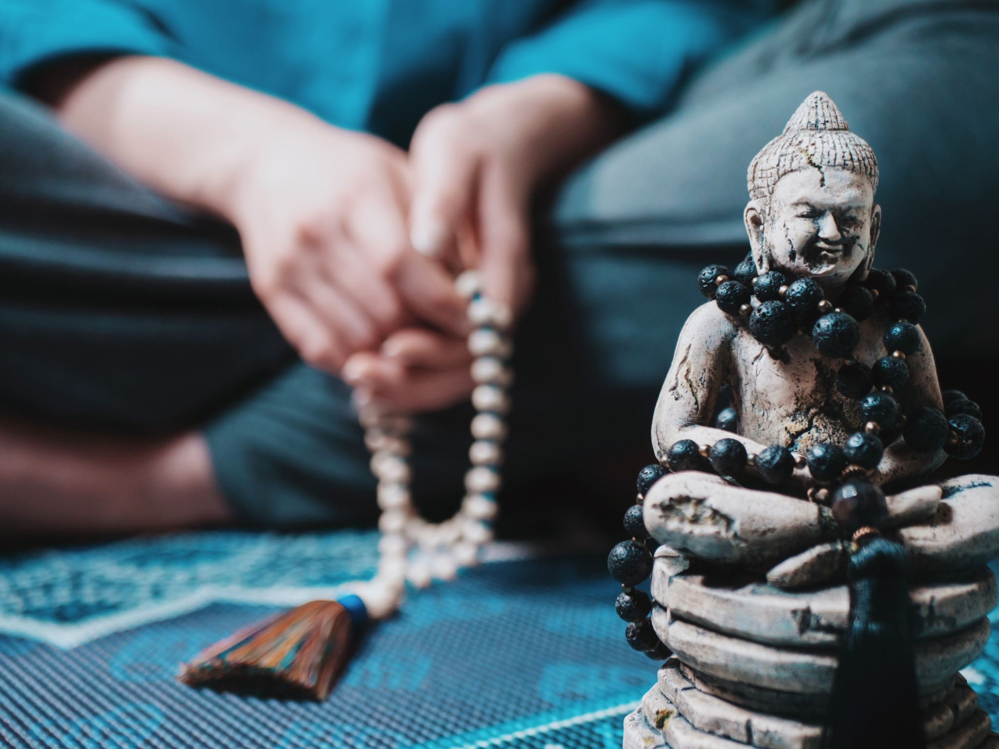
Contemplative Psychotherapy
Combines Tibetan Buddhism and Western psychology
Four tenets:
  The Truth of Suffering: People tend to ignore, deny, or dispute their painful experiences, but life will always have suffering.
  The Truth of the Origin of Suffering: Pain originates from attempts to create an unchanging ego or self.
  The Truth of the Cessation of Suffering: People can free themselves once they let go of creating a permanent, distinct self.
  The Truth of the Path: Once they accept this, they can determine the path that is uniquely theirs.
The therapist’s ability to stay in the present moment, which is impacted by their own self-awareness through contemplative practices, is essential.

Slide 3
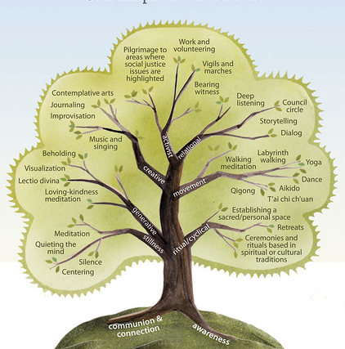
Application
Non-pathologizing is emphasized frequently.
Deep listening
The number of practices is essentially limitless
Top-down, bottom-up approaches, or a mixture of both
Goal: The client reconnects with their wholeness.

Slide 4
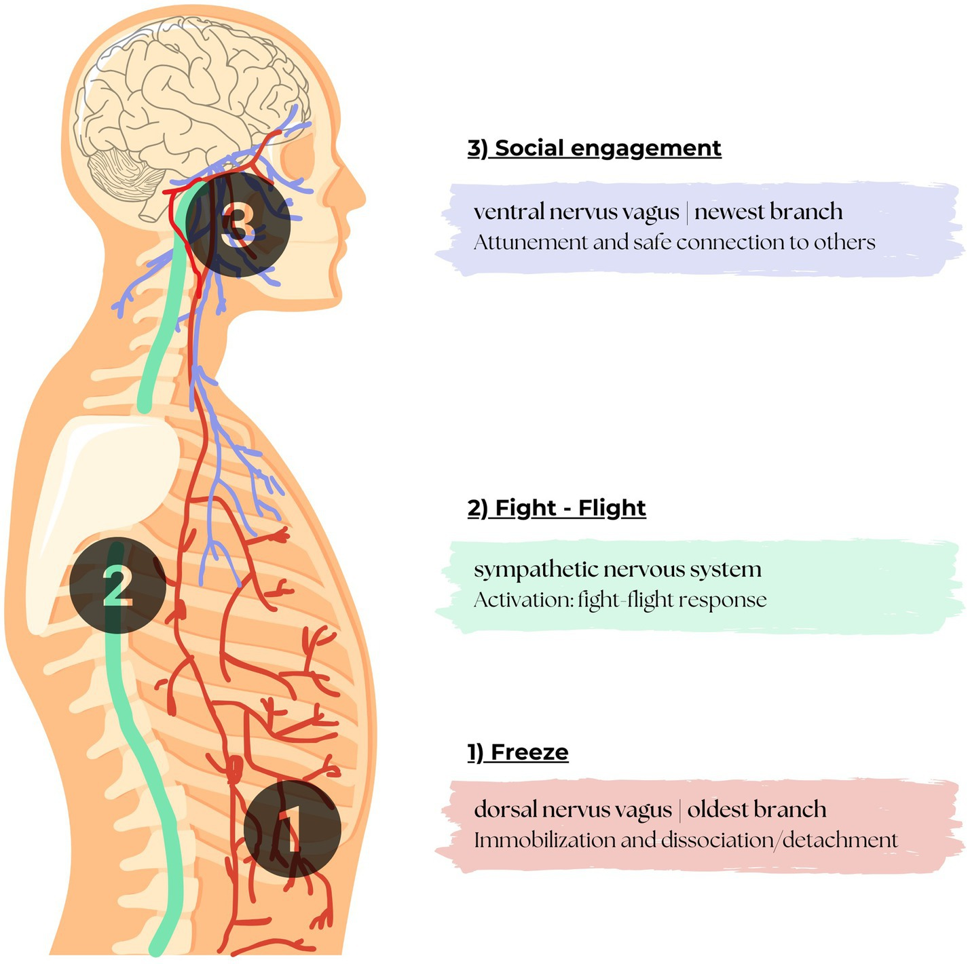
Polyvagal Therapy
The nervous system is shaped by safety and connection.
There are three levels:
  Ventral Vagal Complex (VVC): A sense of safety, social engagement, such as smiling, frowning, etc.
  Sympathetic Nervous System (SNS): Mammalian, fight or flight.
  Dorsal Vagal Complex (DVC): Reptilian, parasympathetic, collapse or shutdown, nausea, shallow breathing.
Polyvagal ladder: Model for regulation

Slide 5
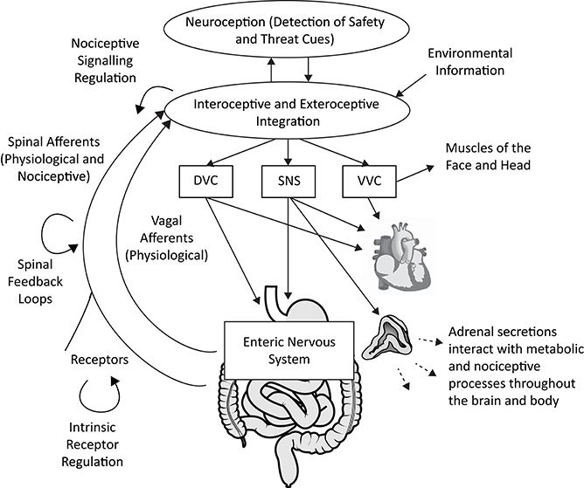
Application
Tracking the client’s nervous system.
The therapist and client maintain co-regulation.
Bottom-up approaches such as martial arts, dancing, and breathwork.
Goal: The client builds flexibility and resiliency in their nervous system.

Slide 6
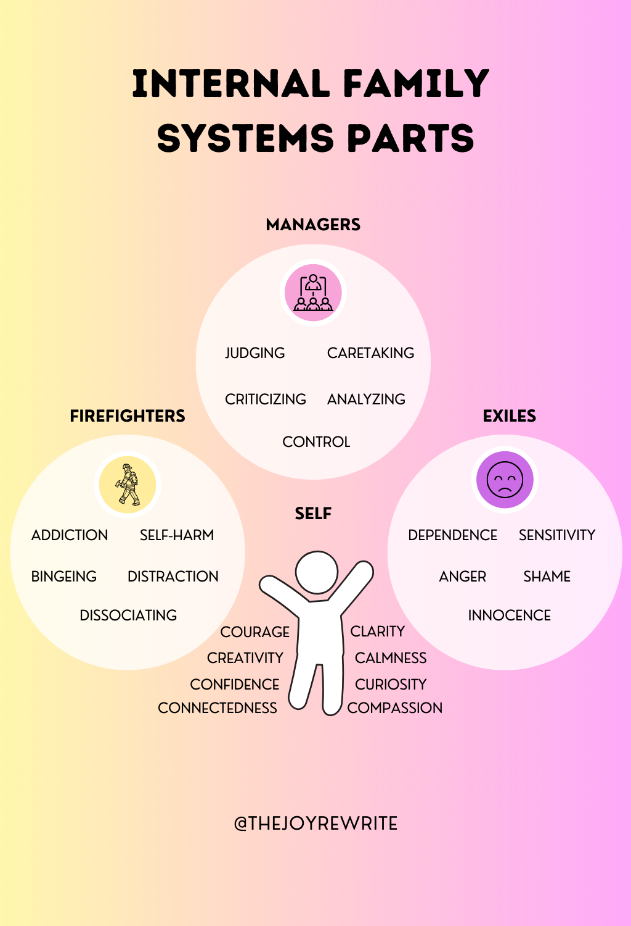
Internal Family Systems
Modality views the mind as a “mosaic” with many personalities or parts
Everyone has a part that is curious, calm, and compassionate
Each part has a protective role
Exile: These parts are often the ones that have childlike fun and wonder, but they have also been hurt the most.
Manager: These parts are critical and perfectionistic, which keeps us relentlessly productive and prevents us from getting close to anyone.
Firefighter: These parts are the emergency responders that act impulsively when you get triggered.

Slide 7
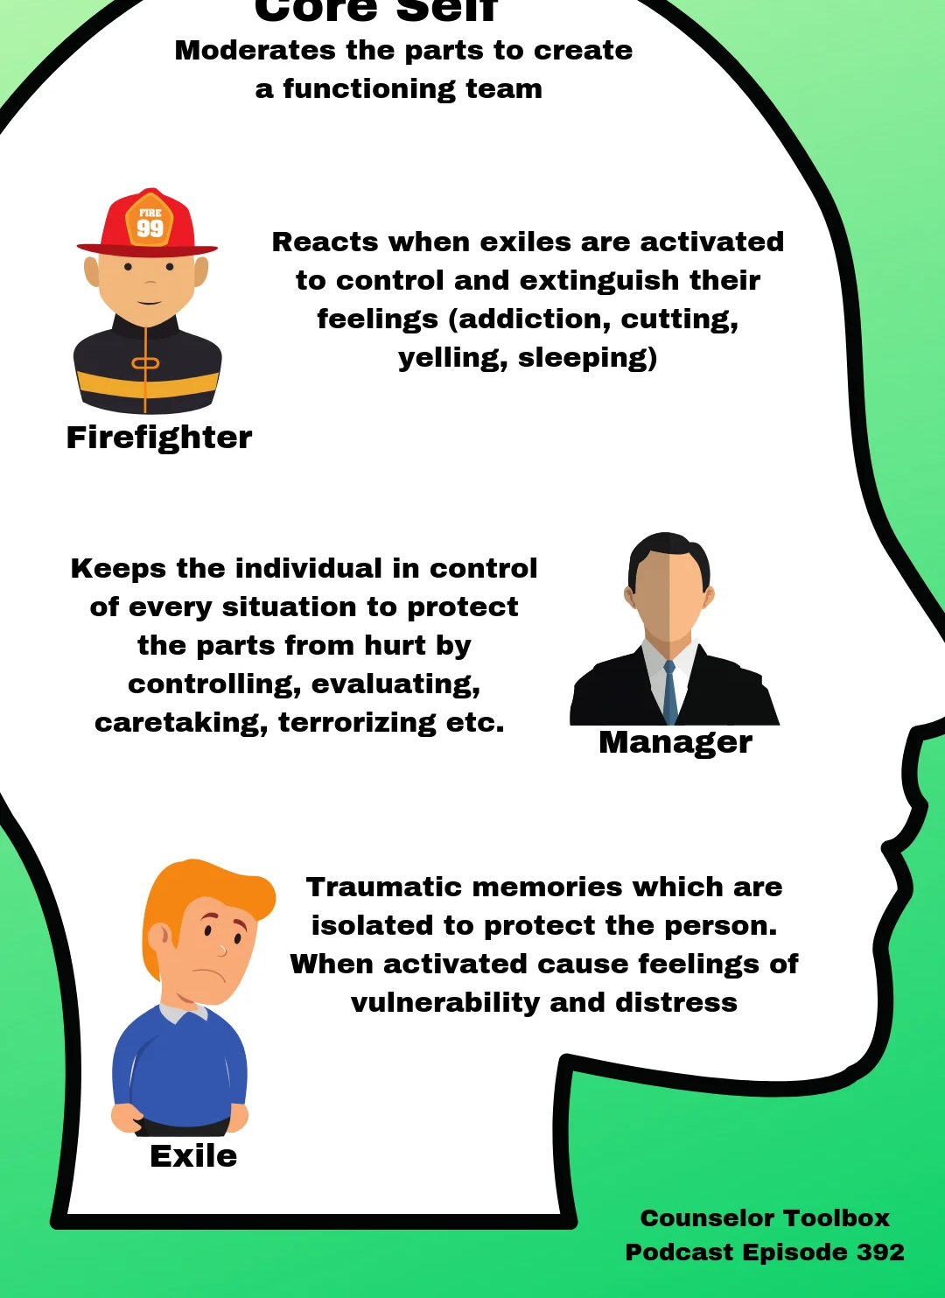
Application
Create a dialogue with the parts.
Build a healthy relationship between the self, the calm, curious, and compassionate part, and the other parts.
All parts were created in an attempt to prevent the self from the terror of death.
All parts are welcome.
Goal: The client finds peace through self-leadership.

Slide 8




Next Steps
Educators and public health workers across the world who believe in these modalities have been creating a new one, sometimes without even realizing it.
I use the acronym E.H.F therapy.
E: Eternal
H: Hope
F: Formula

Slide 9
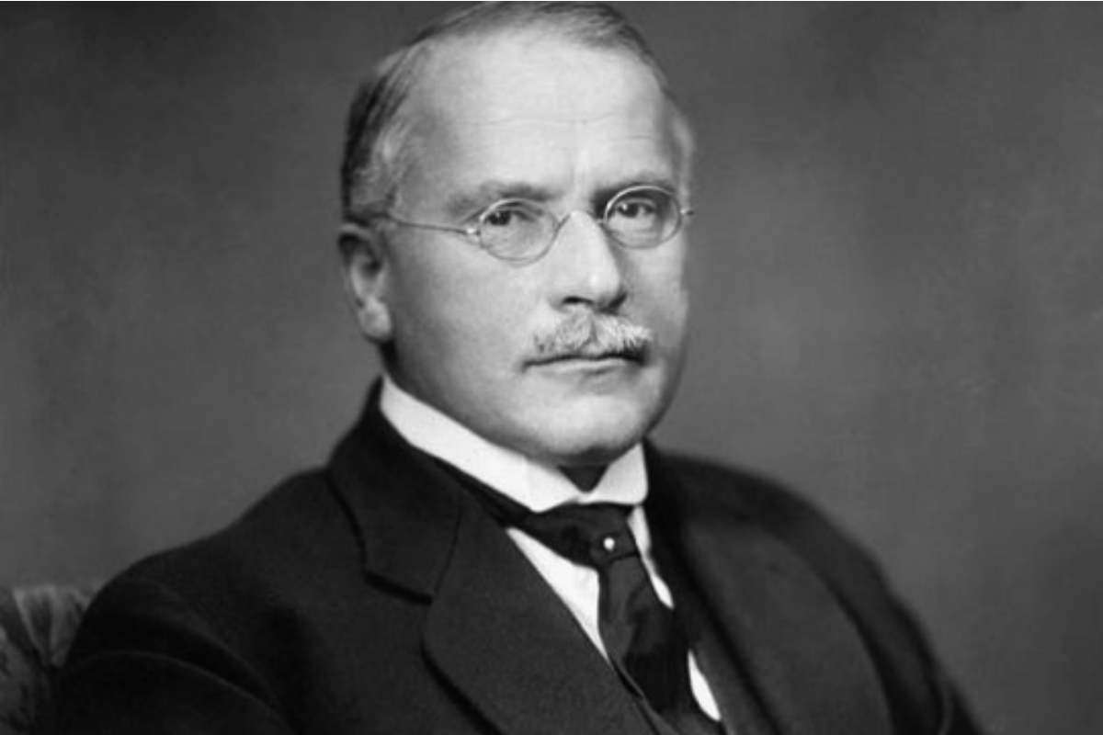
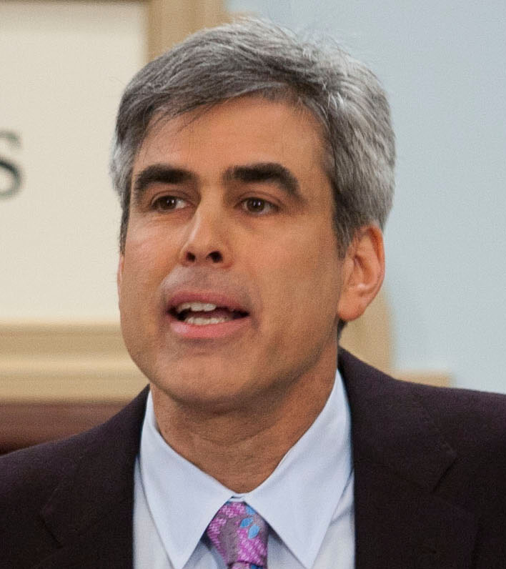
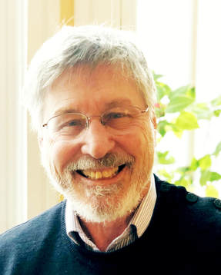
Some Sources of Inspiration
Bessel van der Kolk's The Body Keeps the Score on the biology of trauma
Carl Jung’s Modern Man in Search of a Soul on the psyche, shadow, and meaning
Jonathan Haidt’s work on morality, values, and social cohesion
RaQuel Hopkins work on capacity

